Slide 1
Randomized Algorithms CS648
Lecture 6
Randomized Quick Sort:
Proof for the Concentration of its running time

Slide 2

Union theorem
Theorem:
Suppose there is an event $ε$defined over a probability space ($Ω$,P) such that $ε$ = $\bigcup_{i}{ ε_{i}}$
then
P($ε$) ≤ $\sum_{i}{ P(ε_{i})}$
Furthermore, if $P(ε_{i})$ is same for each $i$, then
P($ε$) ≤ $n$ $P(ε_{i})$

Slide 3
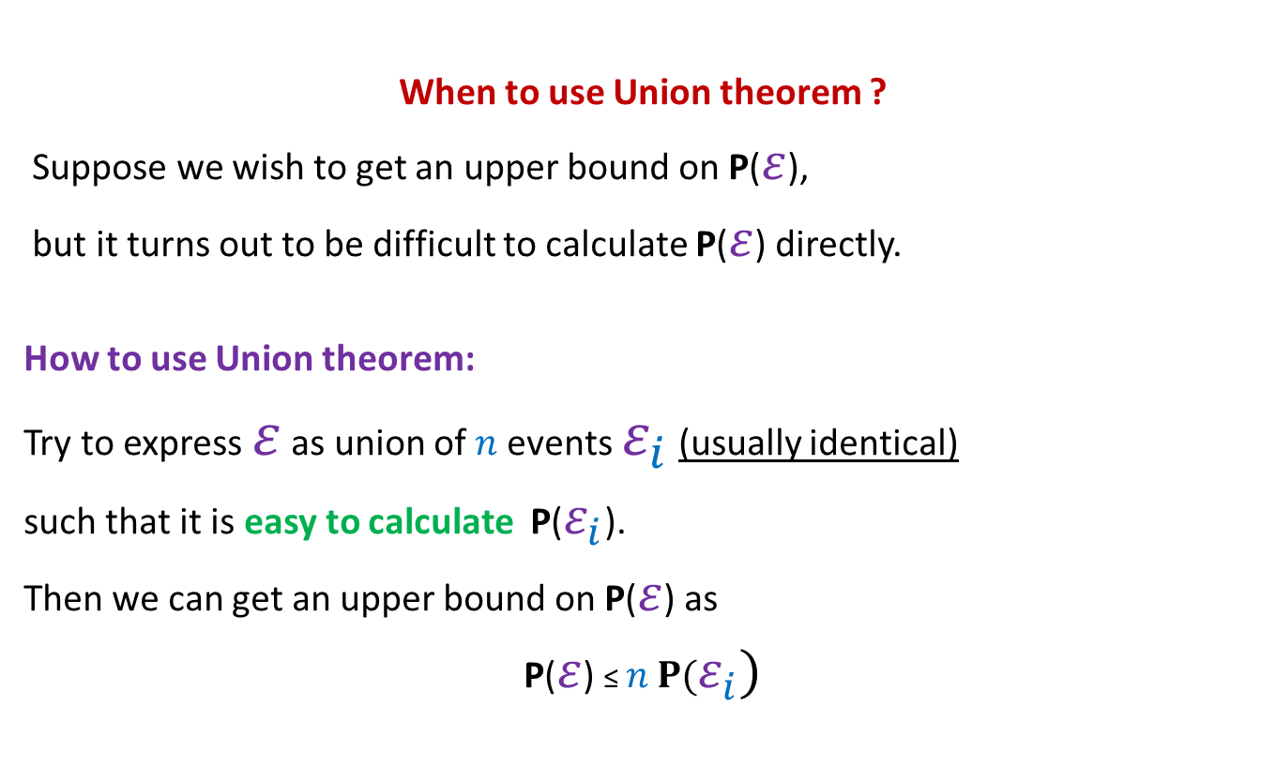
Union theorem
When to use Union theorem ?
Suppose we wish to get an upper bound on P($ε$),
but it turns out to be difficult to calculate P($ε$) directly.
How to use Union theorem:
Try to express $ε$ as union of $n$events $ε_{i}$ (usually identical)
such that it is easy to calculate P($ε_{i}$).
Then we can get an upper bound on P($ε$) as
P($ε$) ≤ $n$ $P(ε_{i})$

Slide 4
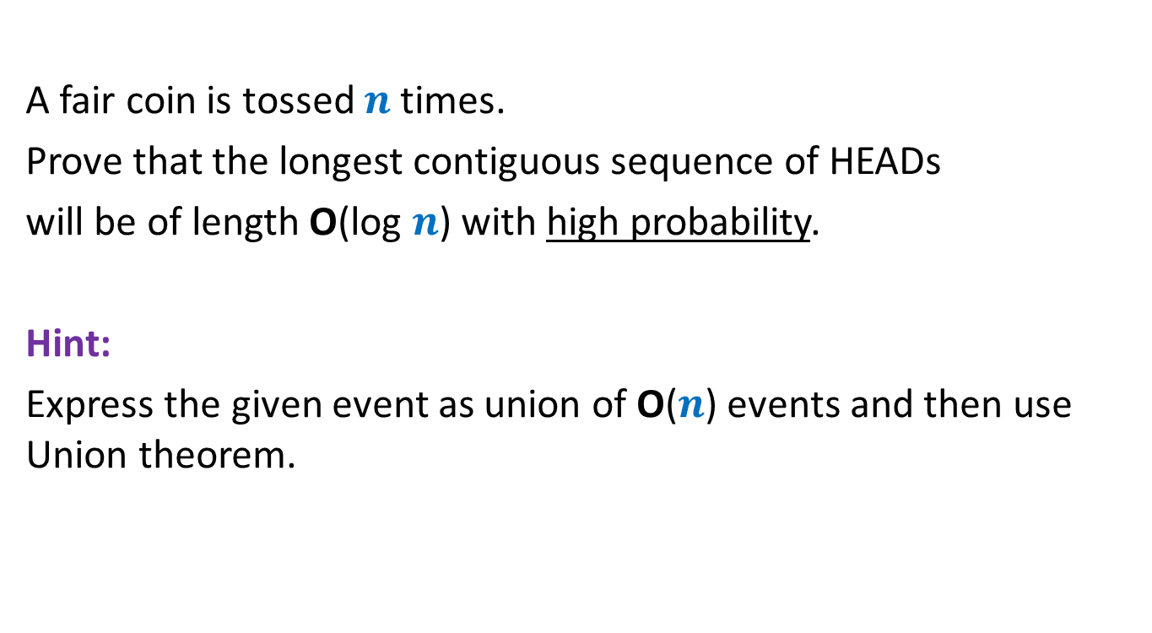
Homework
A fair coin is tossed $n$ times.
Prove that the longest contiguous sequence of HEADs
will be of length O(log $n$) with high probability.
Hint:
Express the given event as union of O($n$) events and then use Union theorem.

Slide 5
Application 2 of the Union Theorem
Randomized Quick sort:
Concentration of its running time

Slide 6
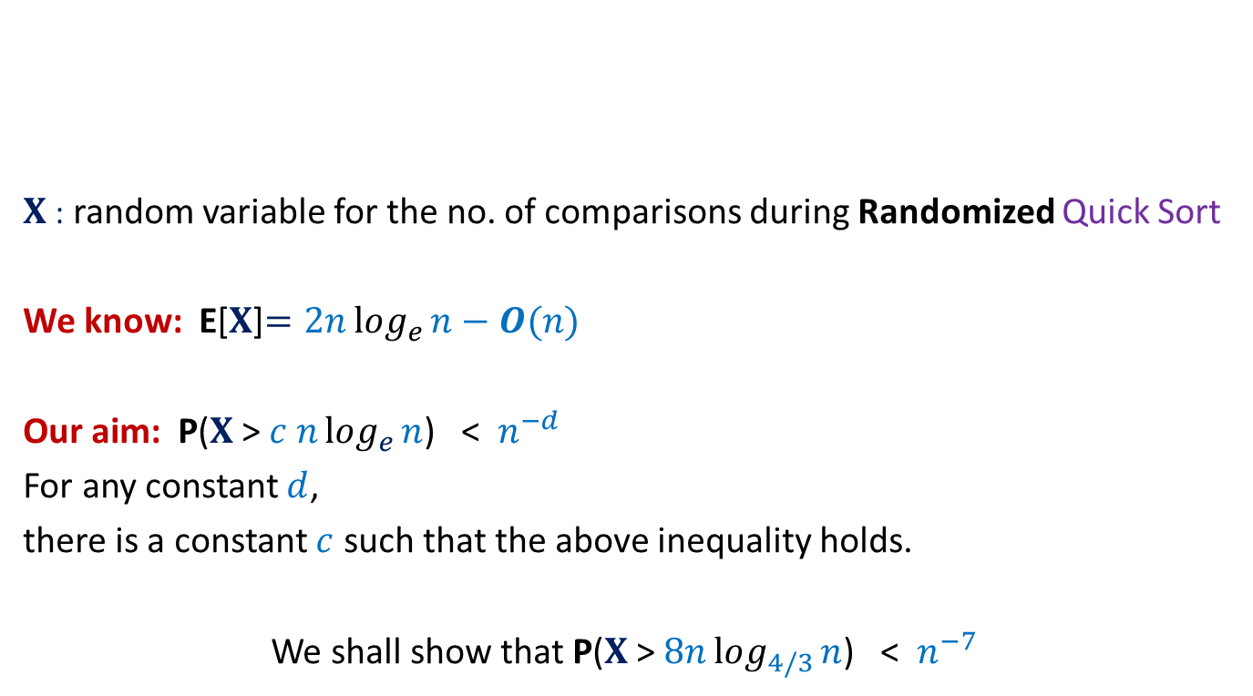


Concentration of running time of Randomized Quick Sort
$X$: random variable for the no. of comparisons during Randomized Quick Sort
We know: E[$X$]$=2nlog_{e}{n}−O(n)$
Our aim: P($X$ > $c nlog_{e}{n}$) < $n^{−d}$
For any constant $d$,
there is a constant $c$ such that the above inequality holds.
We shall show that P($X$ > $8nlog_{4/3}{n}$) < $n^{−7}$
$1$ …
$$n$$
A

Slide 7

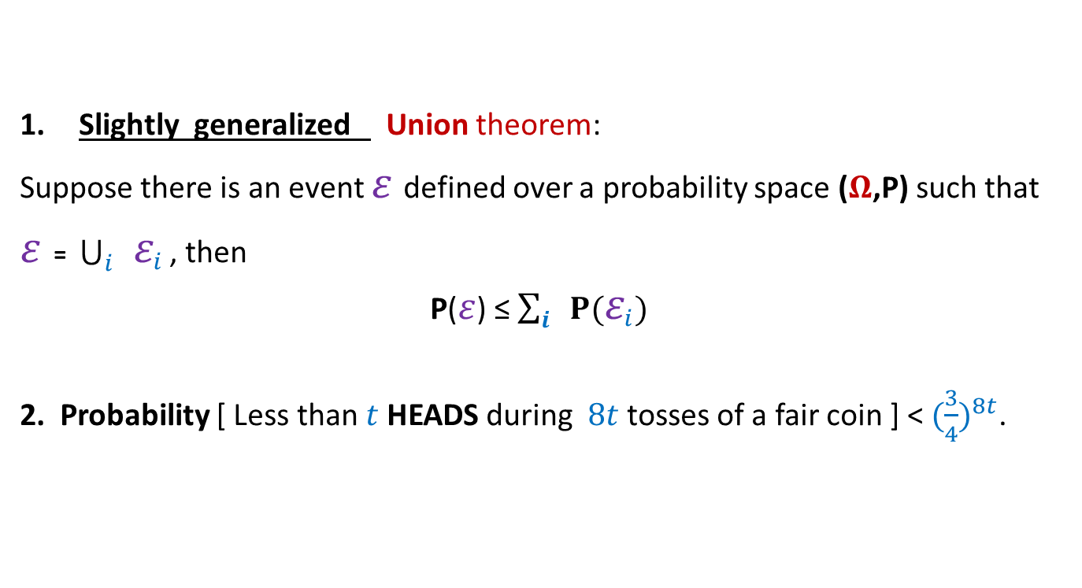
Concentration of running time of Randomized Quick Sort
Slightly generalized Union theorem:
Suppose there is an event $ε$defined over a probability space ($Ω$,P) such that
$ε$ = $\bigcup_{i}{ ε_{i}}$ , then
P($ε$) ≤ $\sum_{i}{ P(ε_{i})}$
2. Probability [ Less than $t$ HEADS during $8t$tosses of a fair coin ] < ${(\frac{3}{4})}^{8t}$.
Tools needed
$$⊆$$

Slide 8
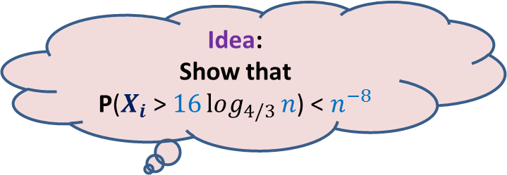





Randomized QuickSort
Idea:
Show that
P($X_{i}$ > $16log_{4/3}{n}$) < $n^{−8}$
Idea fails.
How to apply
Union Theorem ?
Aim: To show P($X$ > $8nlog_{4/3}{n}$) < $n^{−7}$
$X_{i}$ : number of comparisons that $e_{i}$ undergoes
$$X =\frac{1}{2} \sum_{i}{X_{i}}$$
$X$ > $8nlog_{4/3}{n}$ ➔ there exists at least one $i$ such that $X_{i}>16log_{4/3}{n}$
But P($X_{i}$ > $16log_{4/3}{n}$) > $n^{−1}$
Reason:
$e_{i}$ will be picked as the first pivot element
with prob. $n^{−1}$.
And so P($X_{i}$ = $n−1$)= $n^{−1}$.
?

Slide 9


What picture comes to mind when Randomized Quick sort makes too many comparisons
$n$= $16$
$$log_{2}{n}$$

Slide 10


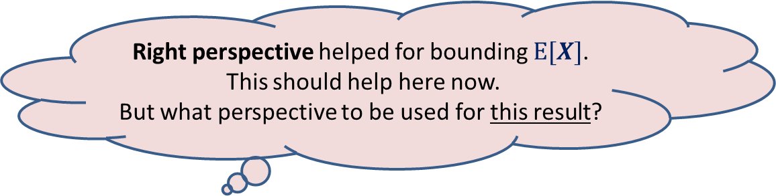

Randomized QuickSort
Right perspective
Elements of A arranged in Increasing order of values
$$e_{i}$$
$$e_{j}$$
Aim: To show P($X$ > $8nlog_{4/3}{n}$) < $n^{−7}$
Right perspective helped for bounding $E[X]$.
This should help here now.
But what perspective to be used for this result?

Slide 11
Randomized QuickSort
Right perspective
Elements of A arranged in Increasing order of values
$$e_{i}$$
Aim: To show P($X$ > $8nlog_{4/3}{n}$) < $n^{−7}$

Slide 12


Randomized QuickSort from perspective of $e_{i}$
Elements of A arranged in Increasing order of values
$$e_{i}$$
$e_{i}$leaves the algorithm

Slide 13

Randomized QuickSort from perspective of $e_{i}$
$Y_{i}$: no. of recursive calls in which $e_{i}$ participates before being selected as a pivot.
Question: Is there any relation between $X$ and $Y_{i}$ ?
Answer: $X=\sum_{i=1}^{n}{Y_{i}}$
Why ?

Slide 14
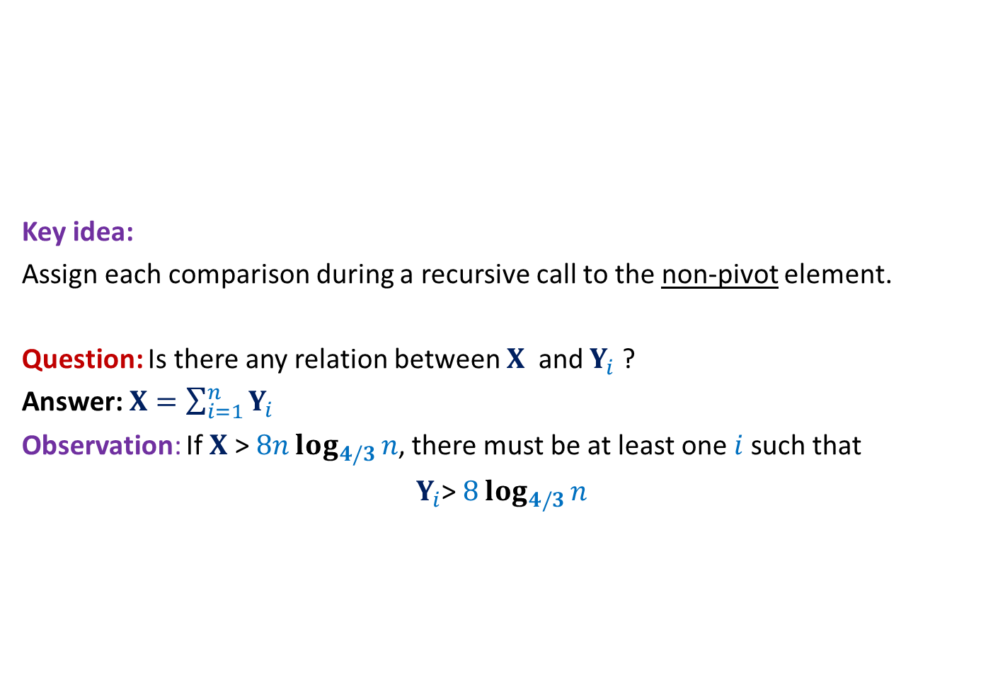
Randomized QuickSort A new way to count the comparisons
Elements of A arranged in Increasing order of values
Key idea:
Assign each comparison during a recursive call to the non-pivot element.
Question: Is there any relation between $X$ and $Y_{i}$ ?
Answer: $X=\sum_{i=1}^{n}{Y_{i}}$
Observation: If $X$ > $8nlog_{4/3}{n}$, there must be at least one $i$such that
$Y_{i}$> $8log_{4/3}{n}$

Slide 15

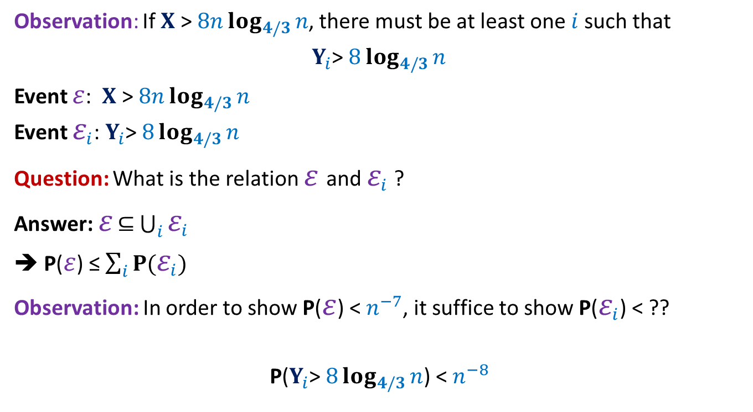
Randomized QuickSort Applying Union theorem
Observation: If $X$ > $8nlog_{4/3}{n}$, there must be at least one $i$such that
$Y_{i}$> $8log_{4/3}{n}$
Event $ε$: $X$ > $8nlog_{4/3}{n}$
Event $ε_{i}$: $Y_{i}$> $8log_{4/3}{n}$
Question: What is the relation $ε$and $ε_{i}$ ?
Answer: $ε$ $⊆$ $\bigcup_{i}{ε_{i}}$
➔ P($ε$) ≤ $\sum_{i}{P(ε_{i})}$
Observation: In order to show P($ε$) < $n^{−7}$, it suffice to show P($ε_{i}$) < ??
P($Y_{i}$> $8log_{4/3}{n}$) < $n^{−8}$
$$n^{−8}$$

Slide 16
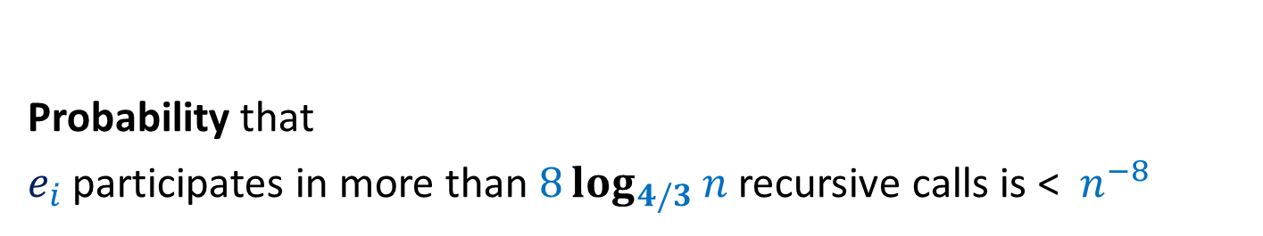

AIM: To show P($Y_{i}$> $8log_{4/3}{n}$) < $n^{−8}$
Probability that
$e_{i}$ participates in more than $8log_{4/3}{n}$ recursive calls is < $n^{−8}$

Slide 17

Randomized Quick Sort
Increasing order of values
Definition:
a recursive call is good if the pivot is selected from the middle half,
and bad otherwise.
P(a recursive call is good) = ??
Notation: The size of a recursive call is the size of the subarray it sorts.
…
middle-half
$$\frac{1}{2}$$

Slide 18
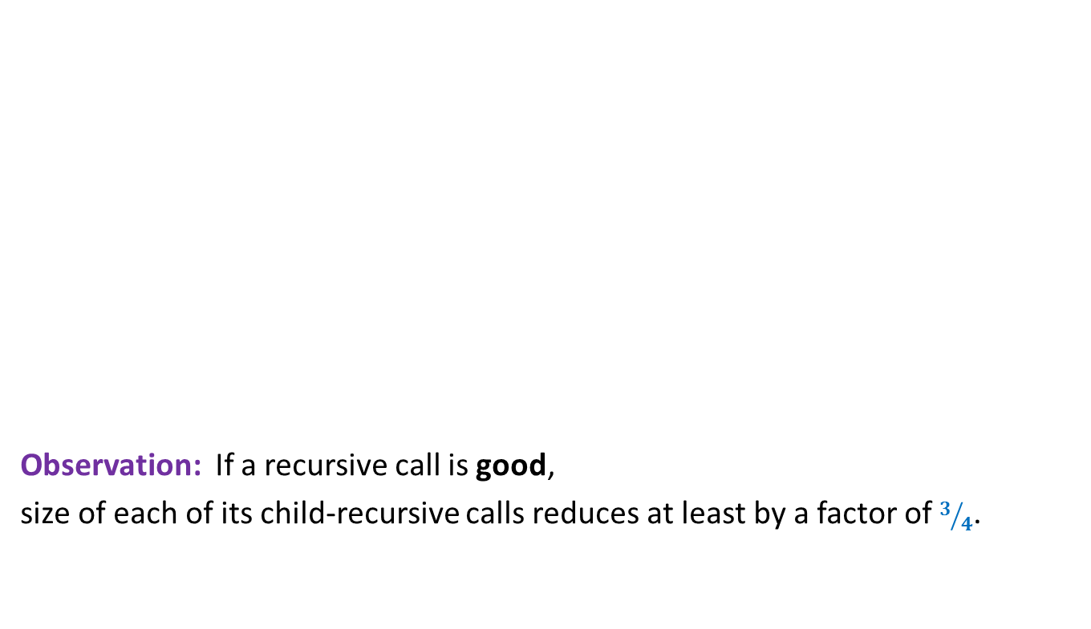
Randomized Quick Sort
Increasing order of values
Observation: If a recursive call is good,
size of each of its child-recursive calls reduces at least by a factor of $3/4$.
…
middle-half

Slide 19

Randomized Quick Sort
$$e_{i}$$
Increasing order of values
Question: What is the maximum no. of good recursive calls $e_{i}$can have in its lifetime?
Answer: $log_{4/3}{n}$.
…
middle-half

Slide 20
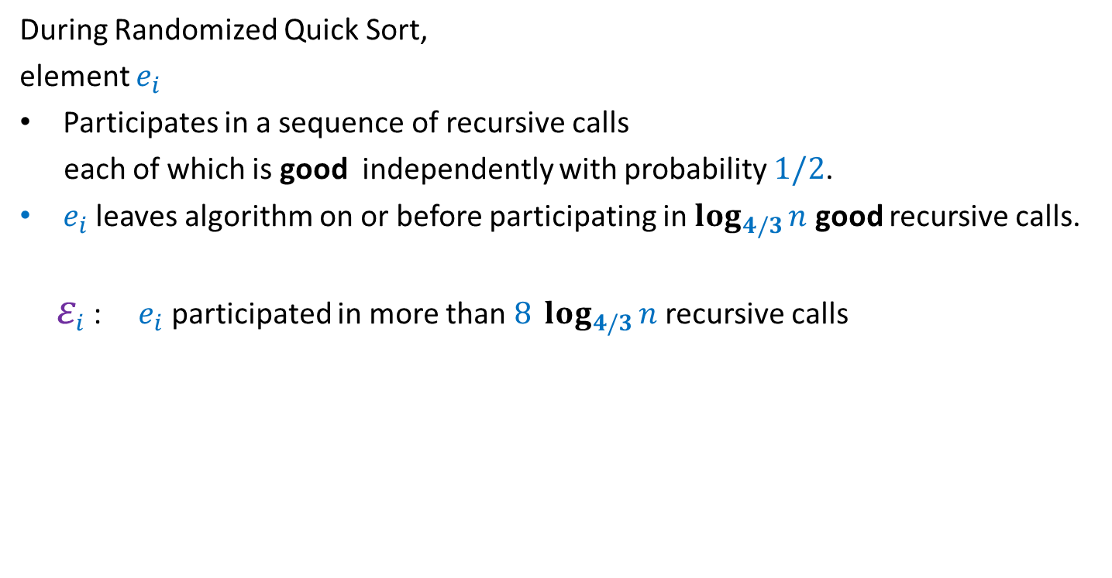

Randomized Quick Sort Summary from the perspective of $e_{i}$
During Randomized Quick Sort,
element $e_{i}$
Participates in a sequence of recursive calls
each of which is good independently with probability $1/2$.
$e_{i}$ leaves algorithm on or before participating in $log_{4/3}{n}$ good recursive calls.
$ε_{i}$: $e_{i}$ participated in more than $8 log_{4/3}{n}$ recursive calls
With this insight, can you express this event in terms of any coin tossing event ?

Slide 21




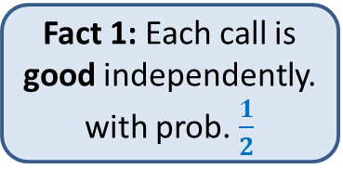
Randomized Quick Sort:
Recursive calls in which $e_{i}$appears
Fact 1: Each call is good independently. with prob. $\frac{1}{2}$
Our insight revealed two facts.
…
Fact 2: $e_{i}$ disappears on or before $log_{4/3}{n}$ good calls
…
$$8 log_{4/3}{n}$$
P[$e_{i}$ appears in more than $8 log_{4/3}{n}$ calls]

Slide 22
Randomized Quick Sort:
Recursive calls in which $e_{i}$appears
Good
Bad
…
Now relate it to some coin tossing experiment.
…
Make an attempt. ☺
$$8 log_{4/3}{n}$$
P[$e_{i}$ appears in more than $8 log_{4/3}{n}$ calls]

Slide 23

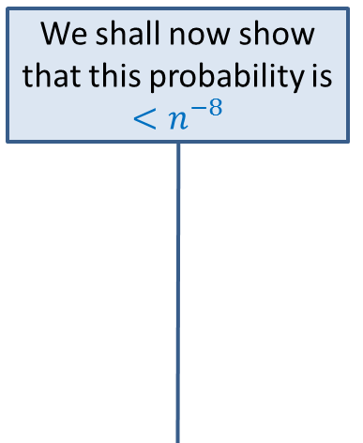

Randomized Quick Sort:
Recursive calls in which $e_{i}$appears
Experiment 1:
We toss a coin and stop on or before
getting $log_{4/3}{n}$ heads
T
T
Good
Bad
H
…
T
…
We shall now show that this probability is $<n^{−8}$
…
…
H
$$8 log_{4/3}{n}$$
T
P[$e_{i}$ appears in more than $8 log_{4/3}{n}$ calls]
P[more than 8 $log_{4/3}{n}$ tosses are made]

Slide 24


Experiment 1’:
Tossing a coin till we get $log_{4/3}{n}$ heads
P[more than $8 log_{4/3}{n}$ tosses are made]
Experiment 2:
Tossing a coin $8 log_{4/3}{n}$ times
P[less than $log_{4/3}{n}$ heads]
?
Intuitively the two probabilities look same.
However, the difficulty in establishing their equality arises since
the two sample spaces are different.
We can get rid of this difficulty by designing an experiment
that captures the essence of both the experiments.

Slide 25

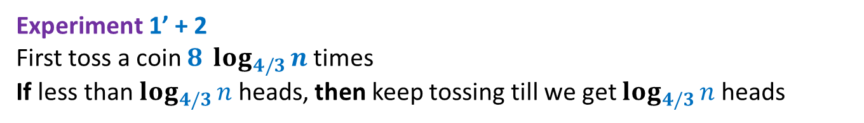

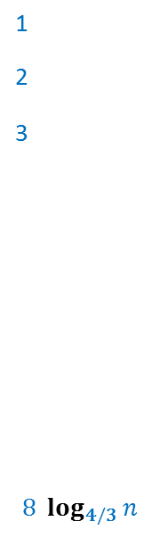
Experiment 1’ + 2 First toss a coin $8 log_{4/3}{n}$times If less than $log_{4/3}{n}$ heads, then keep tossing till we get $log_{4/3}{n}$ heads
Clearly
P[more than $8 log_{4/3}{n}$ tosses are made to get $log_{4/3}{n}$ heads]
$$=$$
P[less than $log_{4/3}{n}$ heads in $8 log_{4/3}{n}$ tosses]
T
1
2
3
$$8 log_{4/3}{n}$$
T
H
$$<n^{−8}$$
T
…
…
The tool
H
T
T
…

Slide 26


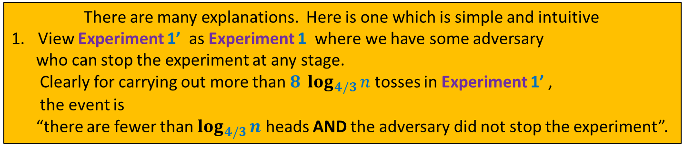

Experiment 1’:
We toss a coin and stop on or before getting $log_{4/3}{n}$ heads
P[more than $8 log_{4/3}{n}$ tosses are made]
Experiment 1:
We toss a coin and stop on getting $log_{4/3}{n}$ heads
P[more than $8 log_{4/3}{n}$ tosses are made]
?
$$≤$$
There are many explanations. Here is one which is simple and intuitive
View Experiment 1’ as Experiment 1 where we have some adversary
who can stop the experiment at any stage.
Clearly for carrying out more than $8 log_{4/3}{n}$ tosses in Experiment 1’ ,
the event is
“there are fewer than $log_{4/3}{n}$ heads AND the adversary did not stop the experiment”.

Slide 27
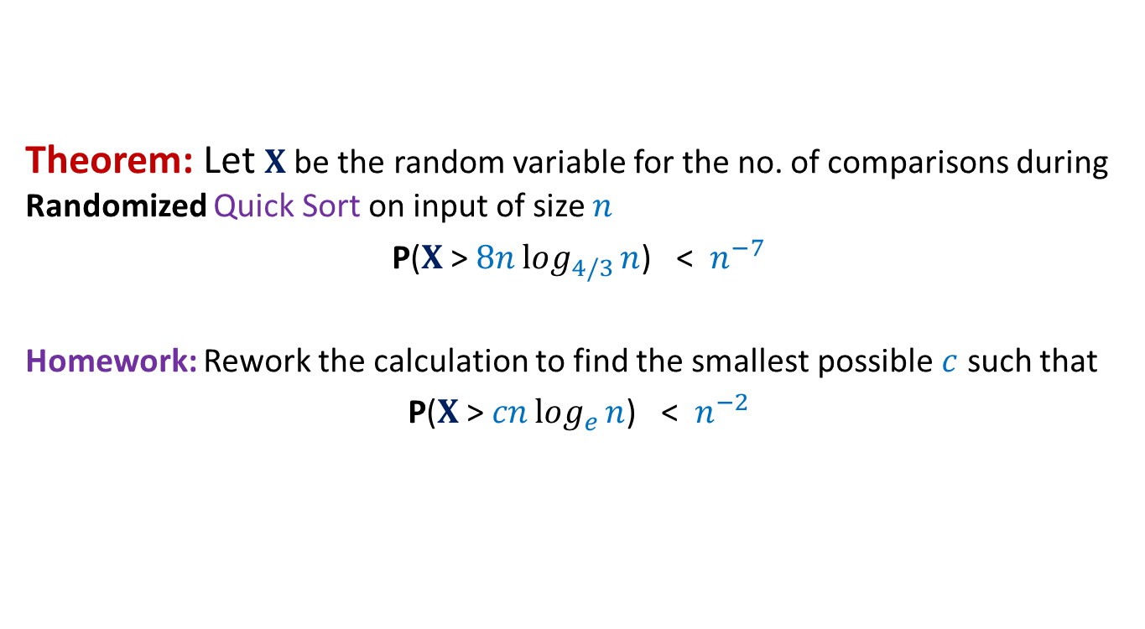
Randomized Quick Sort Final result
Theorem: Let $X$be the random variable for the no. of comparisons during Randomized Quick Sort on input of size $n$
P($X$ > $8nlog_{4/3}{n}$) < $n^{−7}$
Homework: Rework the calculation to find the smallest possible $c$ such that
P($X$ > $cnlog_{e}{n}$) < $n^{−2}$

Slide 28
Some Well Known and Well STUDIED Random Variables

Slide 29
Probability mass function
For a random variable $X$ defined over a discrete probability space (Ω,P)
mass function $p$ is defined as follows.
Question: What is ?
Answer: $1`$
$$p\left(a\right)$$
$$= P(X=a)$$
$$\sum_{∀a∈R}{p\left(a\right) }$$

Slide 30
Bernoulli Random Variable
Bernoulli Random Variable:
A r.v. variable X is said to be a Bernoulli random variable with parameter $p$
if it takes value 1 (success)with prob. $p$ & takes value 0 (failure )with prob. $1−p$.
The corresponding random experiment is usually called a Bernoulli trial.
Example:
Tossing a coin (of HEADS probability= $p$) once,
HEADS corresponds to 1 and TAILS corresponds to 0.
Mass function:
$p$(1)= $p$
$p$(0)= $1−p$
E[X] = $p$

Slide 31

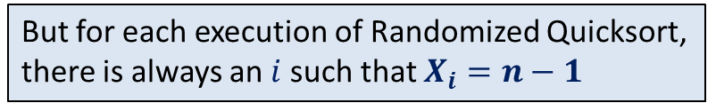
Binomial Random Variable
Binomial Random Variable:
Suppose $n$independent Bernoulli trials each with parameter $p$ are carried out.
Let X denote the number of successes in these trials.
Then X is said to be a Binomial random variable with parameters $n$and $p.$
Example:
number of HEADS when we toss a coin (of HEADs probability= $p$) $n$ times.
Mass function:
$p$($k$)=
Homework:
Prove, without any knowledge of binomial coefficients, that E[X] = $np$.
Hint:
$$\left({n \atop k}\right)p^{k}{\left(1−p\right)}^{k}$$
X = $X_{1}+…{+X}_{n}$
,where $X_{i}$ is a Bernoulli random variable for the $i$th Bernoulli trial.

Slide 32

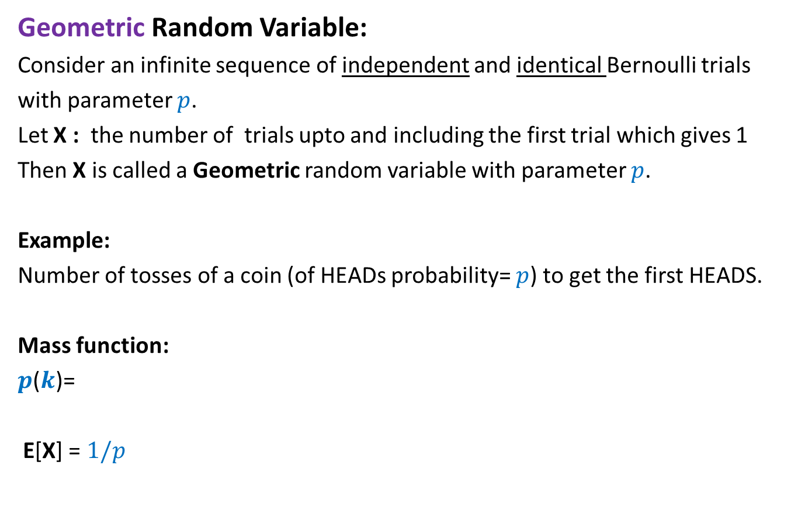
Geometric Random Variable
Geometric Random Variable:
Consider an infinite sequence of independent and identical Bernoulli trials
with parameter $p$.
Let X : the number of trials upto and including the first trial which gives 1
Then X is called a Geometric random variable with parameter $p$.
Example:
Number of tosses of a coin (of HEADs probability= $p$) to get the first HEADS.
Mass function:
$p$($k$)=
E[X] = $1/p$
$${\left(1−p\right)}^{k−1}p$$

Slide 33
Negative Binomial Random Variable
Negative Binomial Random Variable:
Consider an infinite sequence of independent and identical Bernoulli trials
with parameter $p$.
Let X : the number of trials upto and including the trial which gives $n$th success.
Then X is called a negative binomial random variable with parameters $n$and $p$.
Example:
Number of tosses of a coin (of HEADs probability= $p$) to get the $n$HEADS.
Homework:
What is its mass funciton ?
Prove, without any knowledge of binomial coefficients, that E[X] = $n/p$

Slide 34
Load Balance
Project 3

Slide 35
Balls into Bins
1 2 3 4 5 … $m−1$ $m$
Ball-bin Experiment: There are $m$ balls and $n$ bins.
Each ball selects its bin randomly uniformly and independent of other balls
and falls into it.
Applications:
Hashing
Load balancing in distributed environment
1 2 3 … $i$ … $n$

Slide 36
Balls into Bins
1 2 3 4 5 … $m−1 m$
Question : What is the load of most heavily loaded bin ?
1 2 3 … $i$ … $n$
O(log $n$ / log log $n$)

Slide 37
Balls into Bins
$$i$$
1 2 3 … $i$ … $n$

Slide 38
Balls into Bins
$$i$$
Question : What is the load of most heavily loaded bin ?
1 2 3 … $i$ … $n$
O(log log $n$)

Slide 41
Some Well Known and Well STUDIED Random Variables

Slide 42
Bernoulli Random Variable
Bernoulli Random Variable:
A r.v. variable X is said to be a Bernoulli random variable with parameter $p$
if it takes value 1 with probability $p$ and takes value 0 with probability $1−p$.
The corresponding random experiment is usually called a Bernoulli trial.
Example:
Tossing a coin (of HEADS probability= $p$) once,
HEADS corresponds to 1 and TAILS corresponds to 0.
E[X] = $p$

Slide 43

Binomial Random Variable
Binomial Random Variable:
Let $X_{1}$,…, $X_{n}$ be $n$independent Bernoulli random variables with parameter $p$,
then r. v. X= $X_{1}+…{+X}_{n}$
is said to be a Binomial random variable with parameters $n$and $p.$
Example:
number of HEADS when we toss a coin (of HEADs probability= $p$) $n$ times.
Homework:
Prove, without any knowledge of binomial coefficients, that E[X] = $np$.

Slide 44

Geometric Random Variable
Geometric Random Variable:
Consider an infinite sequence of independent and identical Bernoulli trials with parameter $p$.
Let X : the number of trials upto and including the first trial which gives 1
Then X is called a Geometric random variable with parameter $p$.
Example:
Number of tosses of a coin (of HEADs probability= $p$) to get the first HEADS.
Homework:
Find the probability P(X= $i$).
Prove, that E[X] = $1/p$

Slide 45
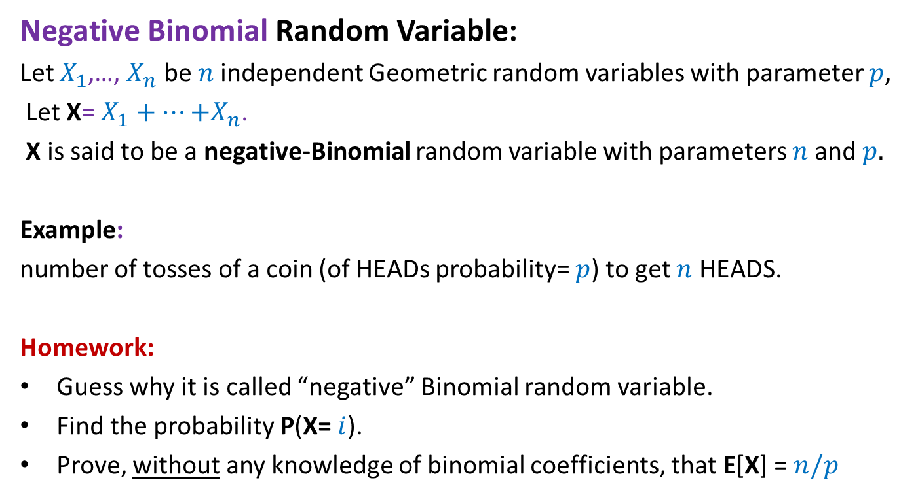
Negative Binomial Random Variable
Negative Binomial Random Variable:
Let $X_{1}$,…, $X_{n}$ be $n$independent Geometric random variables with parameter $p$,
Let X= $X_{1}+…{+X}_{n}$.
X is said to be a negative-Binomial random variable with parameters $n$and $p.$
Example:
number of tosses of a coin (of HEADs probability= $p$) to get $n$ HEADS.
Homework:
Guess why it is called “negative” Binomial random variable.
Find the probability P(X= $i$).
Prove, without any knowledge of binomial coefficients, that E[X] = $n/p$

Slide 46

How to show
P[$X>(1+ε)E[X]$] ?

Slide 47
Tools
Markov’s Inequality
Chebyshev’s Inequality
Chernoff bound
To be derived interactively on
28th January at 11 AM.
Please attend it if you have any doubt.

